Slide 1
Top Down Moodboard

Slide 2
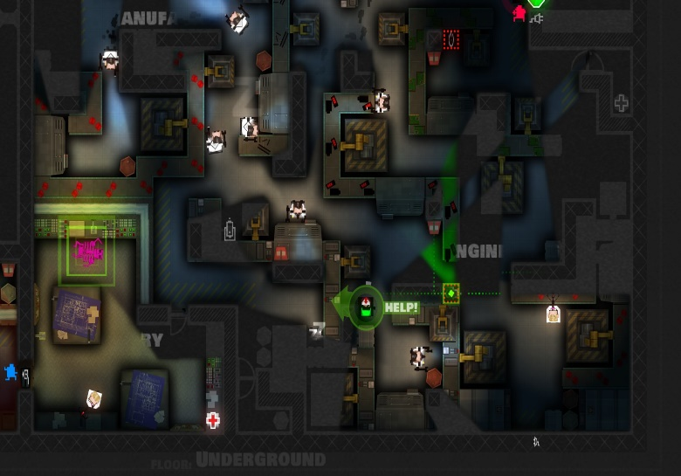
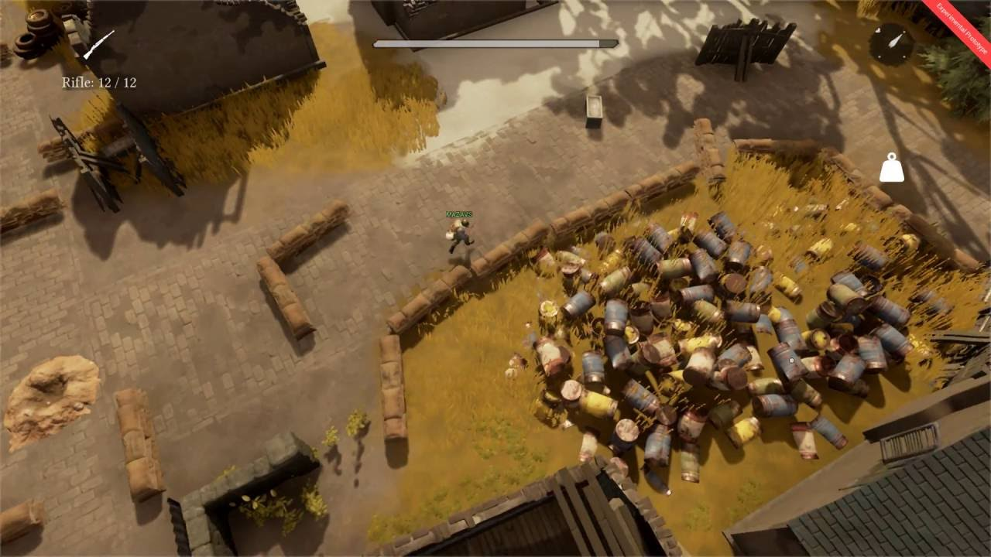
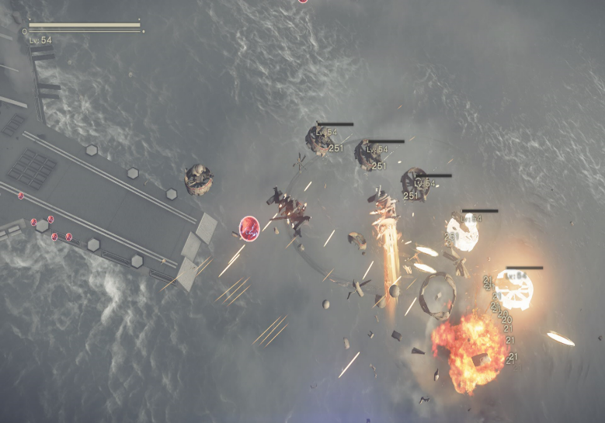
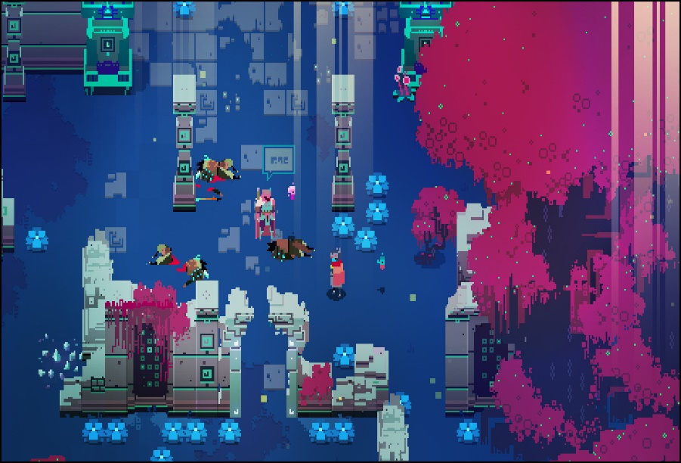
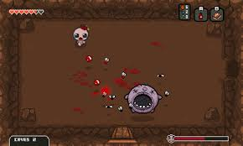
General Design
Bullet design in this section is designed to allow for ease of sight to make sections both fun and fair
A realistic style helps to make the time and somewhat clunky mechanics feel correct due to the implied time
This is a rather minimalistic style and makes all information needed by the players readily available.
The design is rather cartoon styled with a disturbing amount of detail
This is a rather basic style but the contrasting colours help to make important details stand out

Slide 3
Angled Top Down
Angled top-down is a perspective that is commonly used due to the detail that can be implemented visually however there can be problems with the art style from a game play stand point such as determining the position of hazards or enemies precisely.
This can be done through an isometric perspective (see top example) although that amplifies the problems mentioned earlier.

Slide 4

True Top Down
True top down is a lot less common due to the lack of fidelity visually it is mostly reserved for stealth particular shooters and shmups this is due to the fact that gameplay wise all the information is more readily accessible and easier to visualise.

